Slide 1
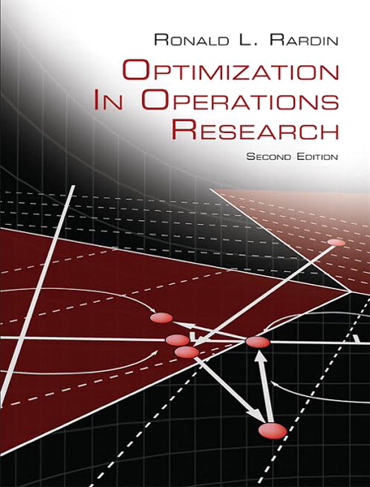
Optimization in Operations Research
Second Edition
Chapter 5
Simplex Search for Linear Programming
Copyright © 2017, 1998 Pearson Education, Inc. All Rights Reserved

Slide 2
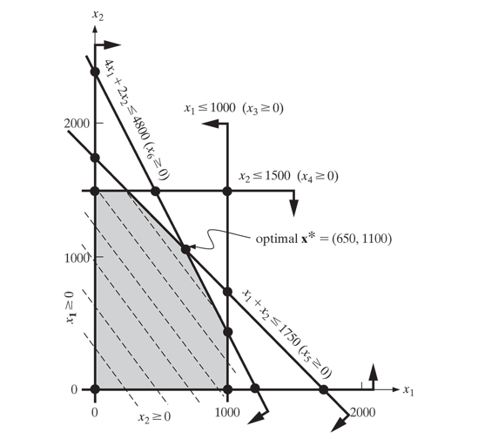
Figure 5.1 Graphical Solution of the Top Brass Trophy Example

Slide 3
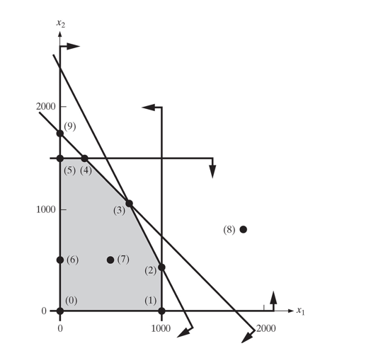
Figure 5.2 Interior, Boundary and Extreme Points of the Top Brass Example

Slide 4
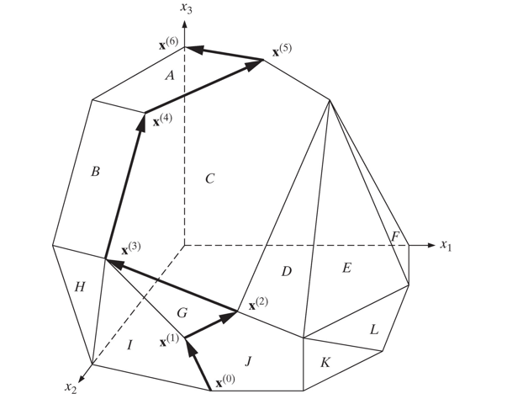
Figure 5.3 Adjacent Extreme Point Search to Max x sub 3 in Three Dimensions

Slide 5
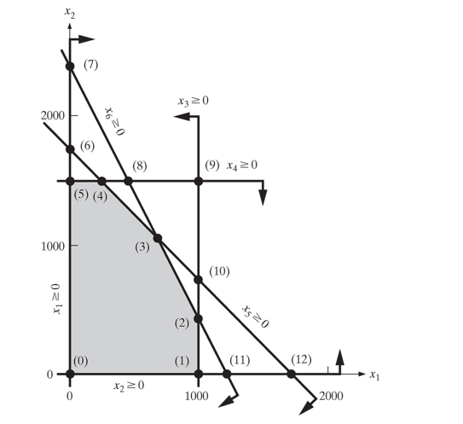
Figure 5.4 Basic Solutions of the Top Brass Example (1 of 2)

Slide 6
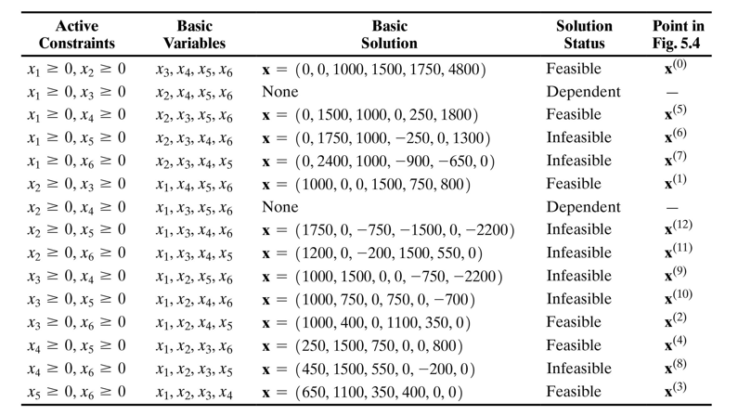
Table 5.1 Basic Solutions of the Top Brass Example (2 of 2)

Slide 7
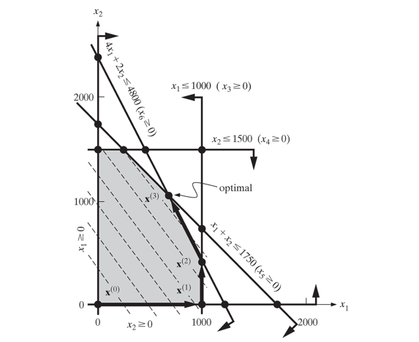
Figure 5.5 Simplex Search of the Top Brass Example

Slide 8
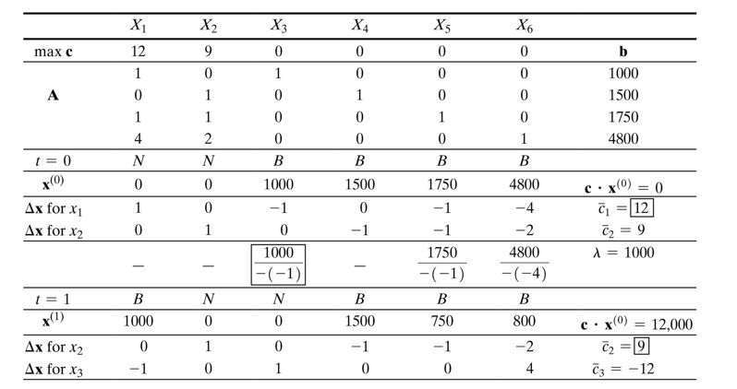
Table 5.2 Rudimentary Simplex Search of Top Brass Trophy Example (1 of 2)

Slide 9
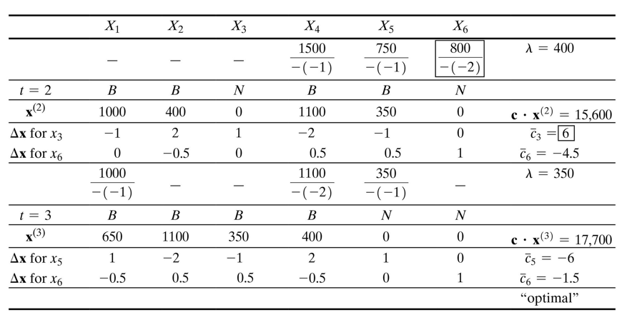
Table 5.2 Rudimentary Simplex Search of Top Brass Trophy Example (2 of 2)

Slide 10
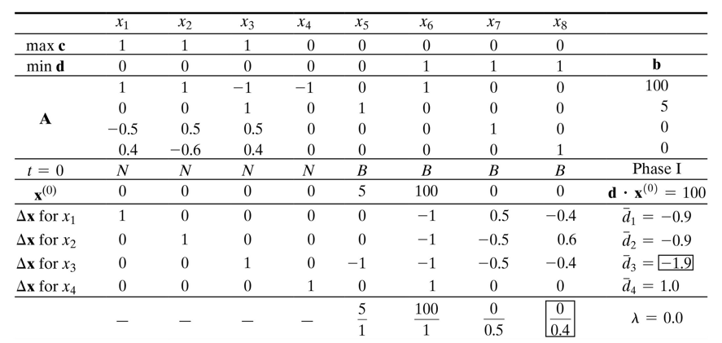
Table 5.3 Simplex Computation for Clever Clyde Infeasible Case (1 of 3)

Slide 11
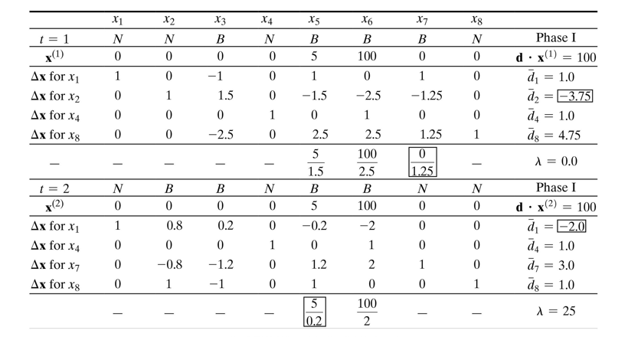
Table 5.3 Simplex Computation for Clever Clyde Infeasible Case (2 of 3)

Slide 12
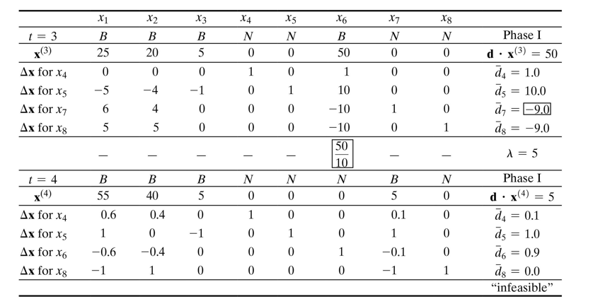
Table 5.3 Simplex Computation for Clever Clyde Infeasible Case (3 of 3)

Slide 13
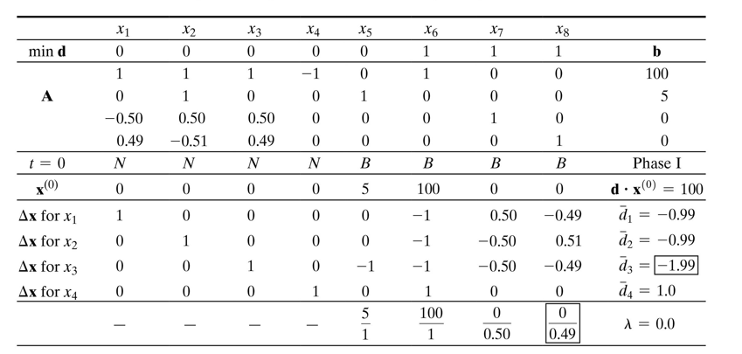
Table 5.4 Phase I Simplex Computation for Clever Clyde Optimal Case (1 of 3)

Slide 14
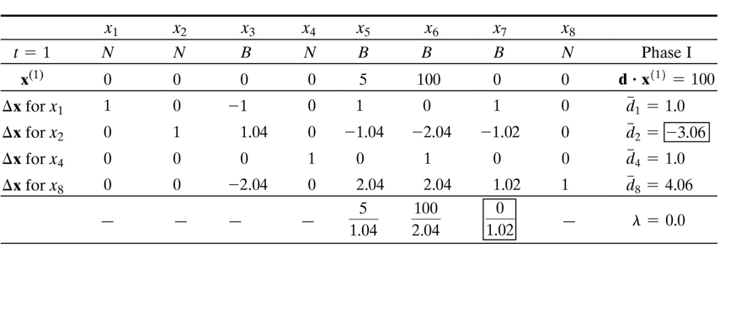
Table 5.4 Phase I Simplex Computation for Clever Clyde Optimal Case (2 of 3)

Slide 15
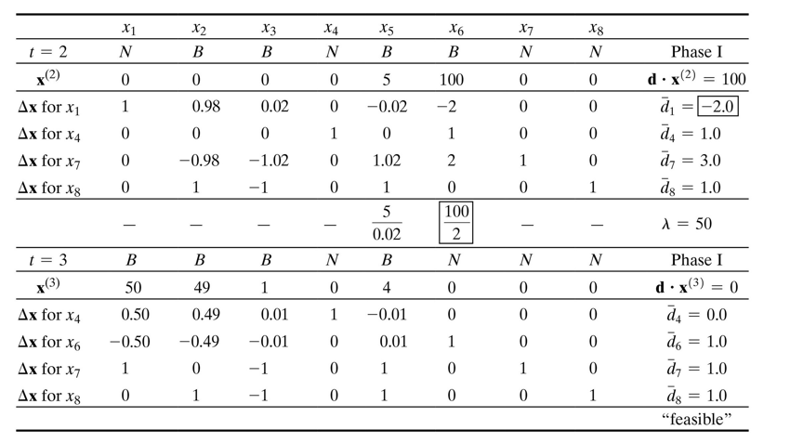
Table 5.4 Phase I Simplex Computation for Clever Clyde Optimal Case (3 of 3)

Slide 16
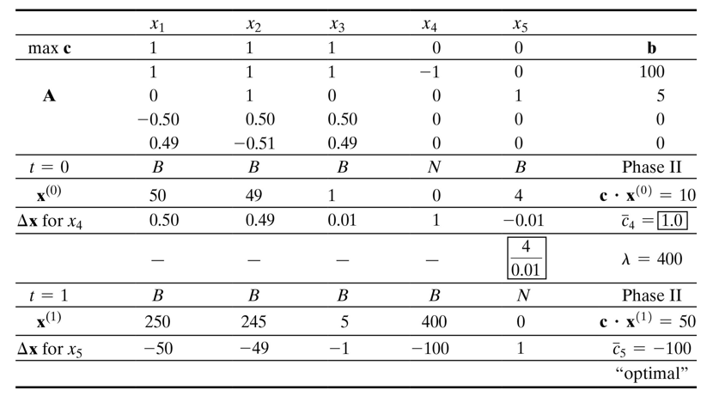
Table 5.5 Phase II Simplex Computation for Clever Clyde Optimal Case (1 of 2)

Slide 17
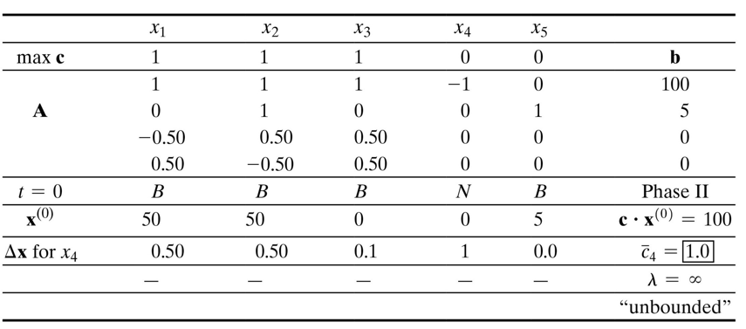
Table 5.6 Phase II Simplex Computation for Clever Clyde Optimal Case (2 of 2)

Slide 18
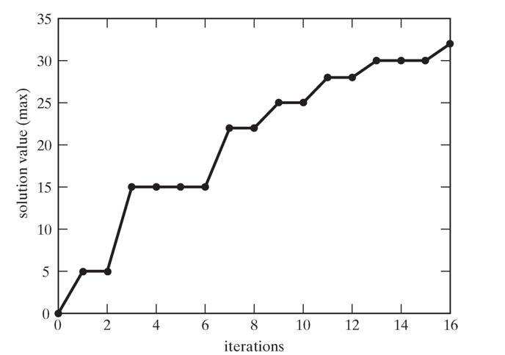
Figure 5.6 Typical Objective Function Progress of Simplex Search

Slide 19
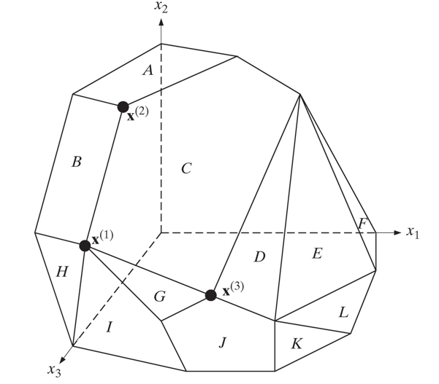
Figure 5.7 Degenerate Extreme Point x super left parenthesis 1 right parenthesisx

Slide 20
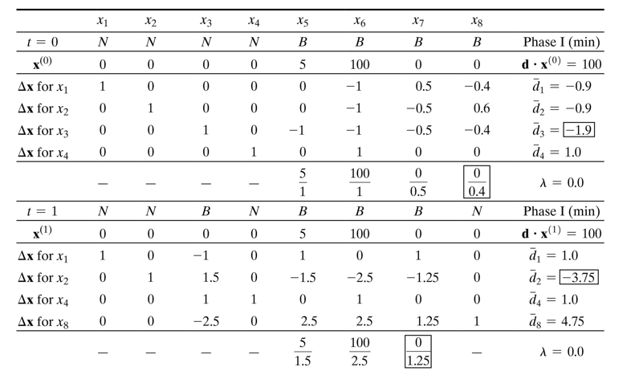
Table 5.7 Degenerate Iterations in Clever Clyde Application (1 of 2)

Slide 21
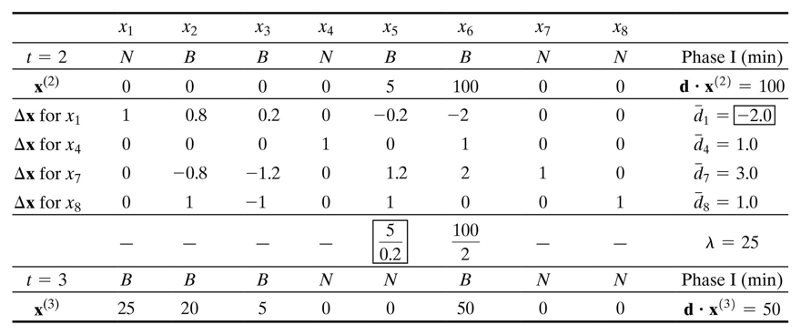
Table 5.7 Degenerate Iterations in Clever Clyde Application (2 of 2)

Slide 22
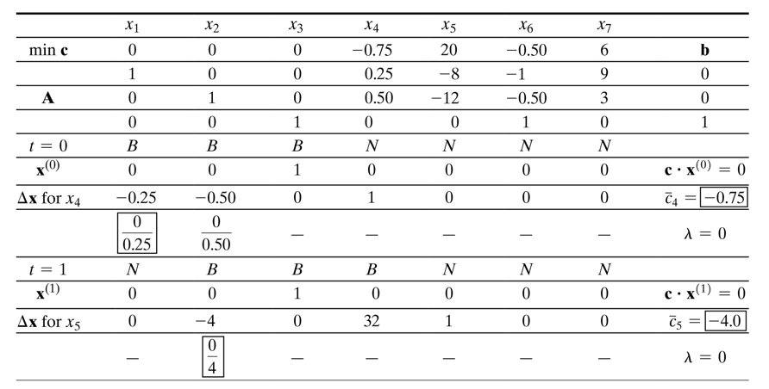
Table 5.8 Example of Cycling with Simplex (1 of 3)

Slide 23
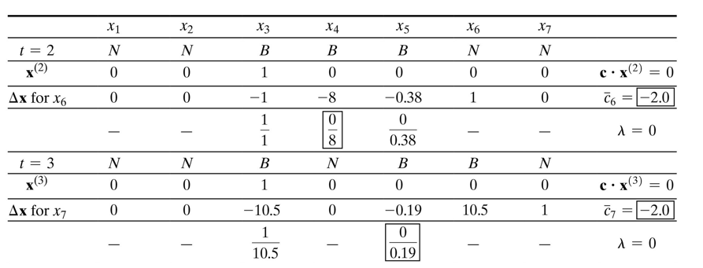
Table 5.8 Example of Cycling with Simplex (2 of 3)

Slide 24
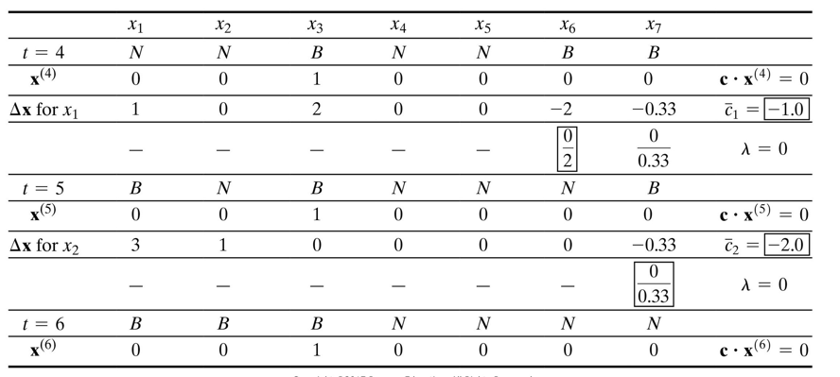
Table 5.8 Example of Cycling with Simplex (3 of 3)

Slide 25
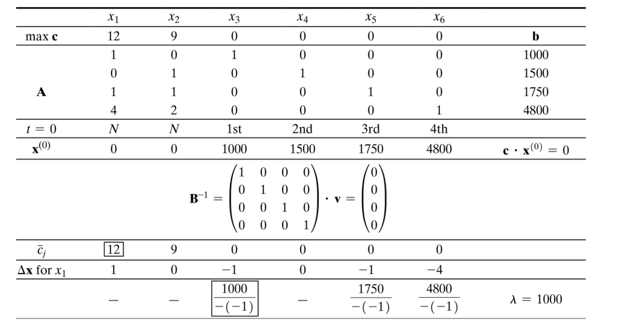
Table 5.9 Revised Simplex Search of Top Brass Trophy Application (1 of 4)

Slide 26
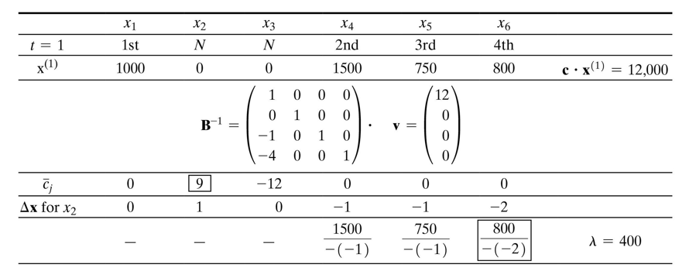
Table 5.9 Revised Simplex Search of Top Brass Trophy Application (2 of 4)

Slide 27
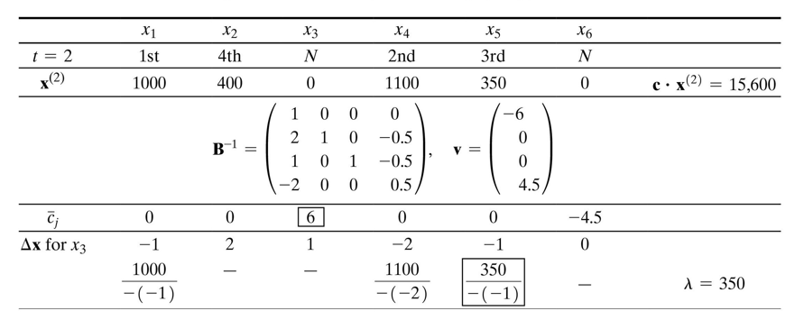
Table 5.9 Revised Simplex Search of Top Brass Trophy Application (3 of 4)

Slide 28
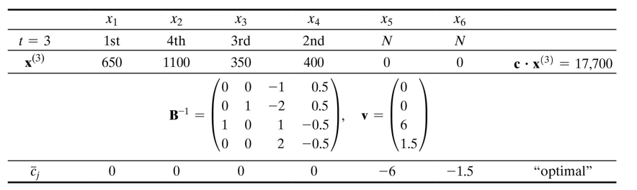
Table 5.9 Revised Simplex Search of Top Brass Trophy Application (4 of 4)

Slide 29
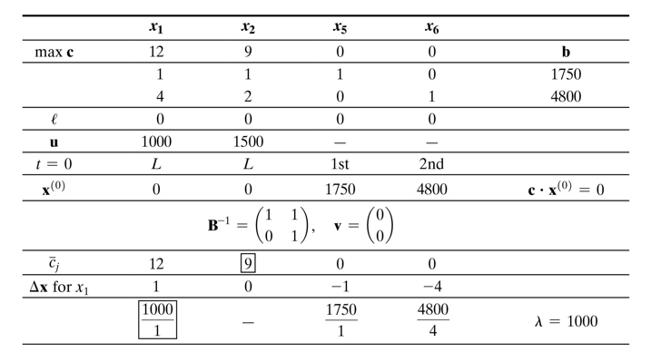
Table 5.10 Upper- and Lower-Bounded Simplex Search of Top Brass Trophy Application (1 of 4)

Slide 30
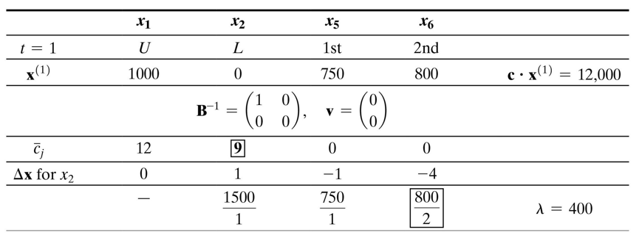
Table 5.10 Upper- and Lower-Bounded Simplex Search of Top Brass Trophy Application (2 of 4)

Slide 31
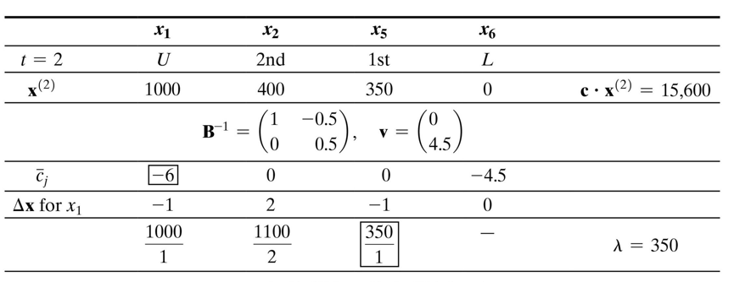
Table 5.10 Upper- and Lower-Bounded Simplex Search of Top Brass Trophy Application (3 of 4)

Slide 32
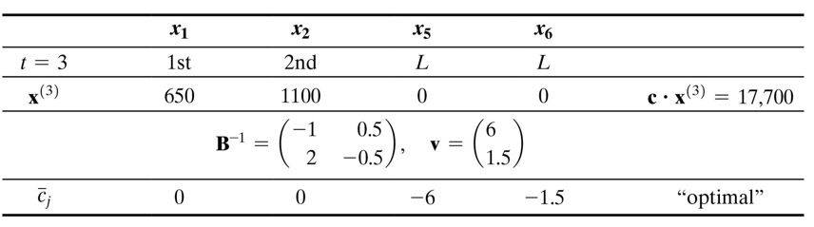
Table 5.10 Upper- and Lower-Bounded Simplex Search of Top Brass Trophy Application (4 of 4)

Slide 33

Copyright
Notes:
If this slide was not included in the original PPT, it should be added.

